Slide 1

MOCK PROJECT
AUTOMATIC DOOR SYSTEM
GROUP 2 HCM24_CPL_EMB_03

Slide 2
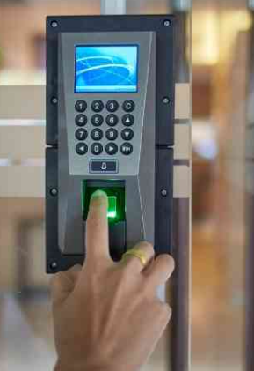
1. OVERVIEW SYSTEM
Fingerprint-Based Door Lock/Unlock System
Add a new user.
Reset the system (clear all users).
Scan and determine valid/invalid fingerprints.
Includes a real-time clock.
Provides a sound warning.
Example of a Fingerprint Door Lock System

Slide 3
2. SOFTWARE REQUIREMENTS
SRS 1: When a stored fingerprint is scanned by the AS608,
SRS 1.1. The LCD shows the user's name
SRS 1.2. The buzzer emits a short sound.
SRS 2: When an unrecognized fingerprint is scanned by the AS608, the LCD displays “NOT FOUND.”
SRS 3: Sending an ID via UART switches the system to IMPORT FINGER MODE.
SRS 4: The name entered via key tap is saved to the MCU.
SRS 5: Pressing “*” on the key tap clears the fingerprint sensor database.
SRS 6: The Real-Time Clock operates correctly.
SRS 7: An incorrect fingerprint will trigger a buzzer sound as a warning.
SRS 8: The RFID will unlock the door without requiring a fingerprint.

Slide 4



3. HARDWARE REQUIREMENTS
Fingerprint Authentication
Minimum resolution of 500 DPI.
Processing and matching fingerprints within 1000 milliseconds
Storage up to 100 unique fingerprint templates.
User management
Interface for enrolling new users
Reset function to erase all stored fingerprint

Slide 5


3. REQUIREMENTS
Real-time clock
Timestamp all events with one-second accuracy.
Sound Warning
Producing sound warnings at a minimum of 85 dB SPL.

Slide 6
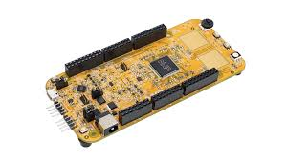
4. HARDWARE INTRODUCTION
4.1 DEVICES
S32K144 key features:
High speed: up to 80MHz in Normal Run Mode
Low power Arm Cotex M4F/M0+ core
Ambient temperature range: -40 °C to 150 °C for RUN mode
Configurable Nested Vectored Interrupt Controller (NVIC)
Internal Real-time Clock Module
Up to 156 GPIO (S32K1xx), 3 LPUART, 1 LPI2C, 2 LPSPI
Up to 2 MB program flash memory with ECC
S32K144

Slide 7
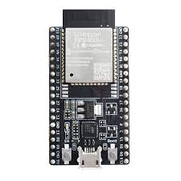
4. HARDWARE INTRODUCTION
4.1 DEVICES
ESP32 key features:
Dual-core Xtensa® 32-bit LX6 microprocessor
Clock speeds up to 240 MHz.
Support integrated 802.11 b/g/n Wi-Fi.
I2C/SPI/UART: Multiple I2C, SPI, and UART interfaces for connecting peripherals.
Low cost
ESP32

Slide 8
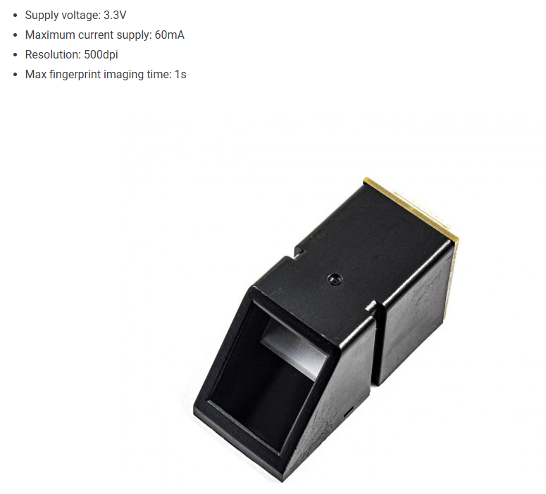
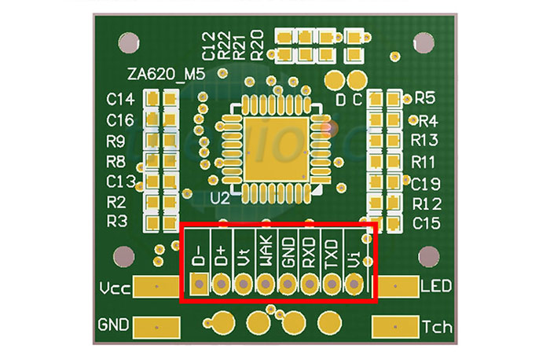
4. HARDWARE INTRODUCTION
4.1 DEVICES
AS608 key features:
Supply voltage: 3.3V
Maximum current supply: 60mA
Resolution: 500dpi
Max fingerprint imaging time: 1s
Up to 99 feature files
Low cost
AS608
AS608 pinout

Slide 9
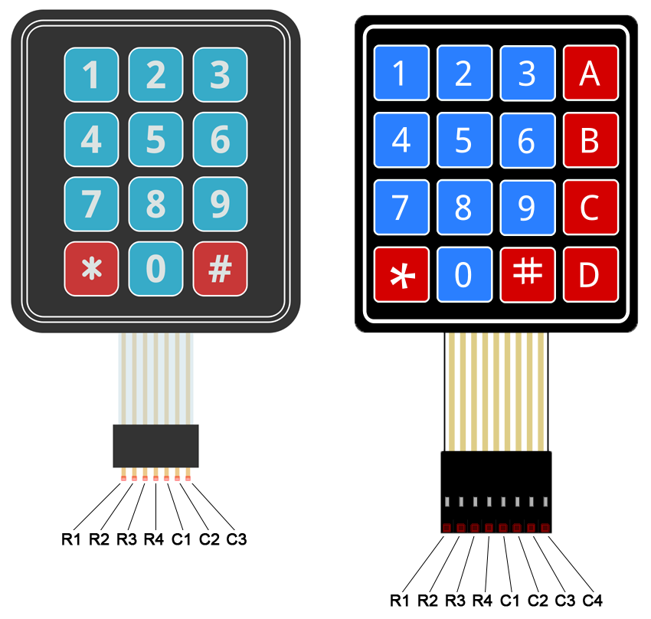
4. HARDWARE INTRODUCTION
4.1 DEVICES
Keypad 4x4 key features:
Maximum operating temperature: 0°C to + 50°C
Ultra-thin design
Adhesive backing
Easy interface
Long life.
Keypad 4x4

Slide 10
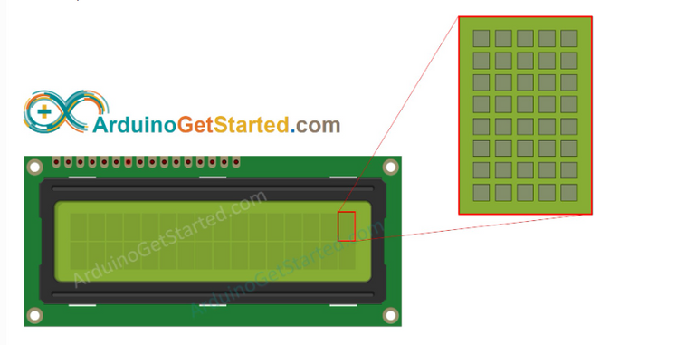

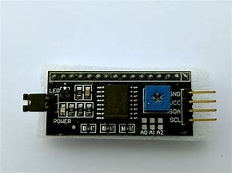
4. HARDWARE INTRODUCTION
4.1 DEVICES
LCD1602 key features:
I2C Address: Adjustable with a jumper.
Display: Shows 16x2 characters. Adjustable
Communication: Two-wire I2C.
Brightness: Adjustable via potentiometer.
LCD 16x2
PCF8574

Slide 11
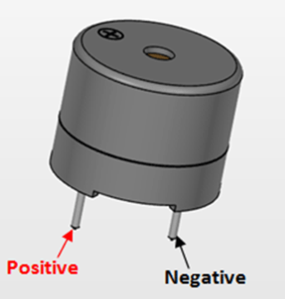
4. HARDWARE INTRODUCTION
4.1 DEVICES
Buzzer key features:
Rated current: <30mA
Sound Type: Continuous Beep
Resonant Frequency: ~2300 Hz
Small and neat sealed package
Buzzer

Slide 12

4. HARDWARE INTRODUCTION
4.2 DIAGRAM CONNECTION
UART
I2C
AS608
S32K144
LCD
Keytap
ESP32
Buzzer

Slide 13
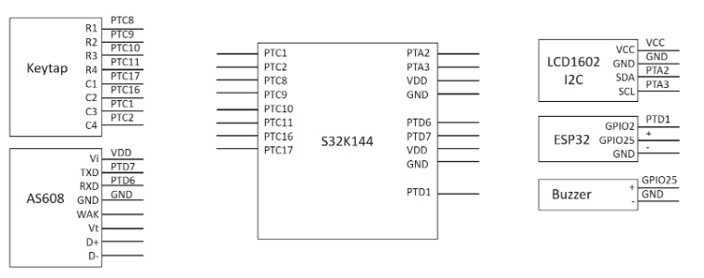
4. HARDWARE INTRODUCTION
4.3 SCHEMATIC

Slide 14
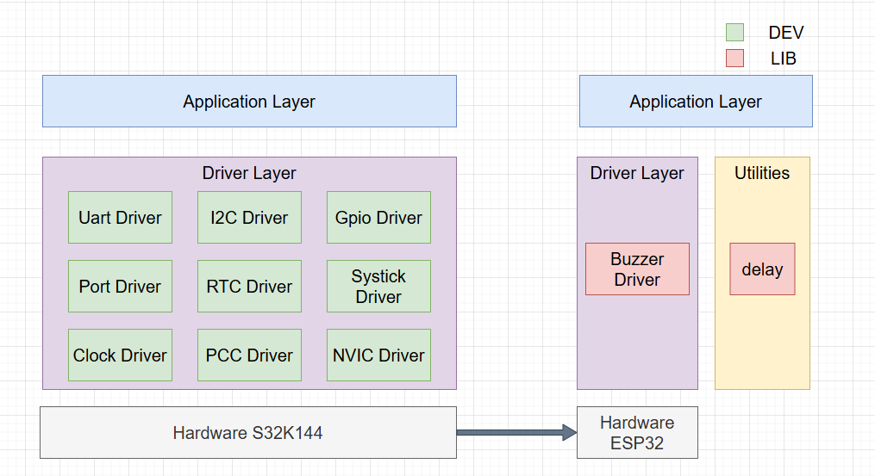
5. SOFTWARE INTRODUCTION
5.1. Software architecture design
Block Diagram Architecture

Slide 15
5. SOFTWARE INTRODUCTION
5.1. Software architecture design
1. PORT BLOCK FUNTIONS
Config input muxing
Config Pull up/ pull down
Config interrupt signal type
2. GPIO BLOCK FUNTIONS
Digital Input
Digital Output
Configuration and Control
3. NVIC BLOCK FUNTIONS
Interrupt Handling
Priority Management
Interrupt Vector Table Management
Enabling/Disabling Interrupts
4. PCC BLOCK FUNTIONS
Peripheral Clock Enabling/Disabling
Clock Source Selection

Slide 16
5. SOFTWARE INTRODUCTION
5.1. Software architecture design
5. UART BLOCK FUNTIONS
Serial Data Transmission
Serial Data Reception
Baud Rate Configuration
Data Framing
Error Detection
6. CLOCK BLOCK FUNTIONS
Frequency Control
Clock running source
7. I2C BLOCK FUNTIONS
Serial Data Communication
Addressing of Devices
Data Acknowledgment
Bus Arbitration
Error detection
8. RTC BLOCK FUNTIONS
Timekeeping
Periodic Interrupts
9. SYSTICK BLOCK FUNTIONS
Periodic Interrupt Generation
System Tick Counting
Time Delay Management

Slide 17
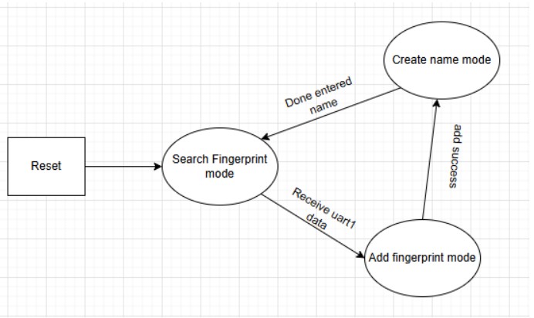
5. SOFTWARE INTRODUCTION
5.1. Software architecture design
SYSTEM STATE

Slide 18
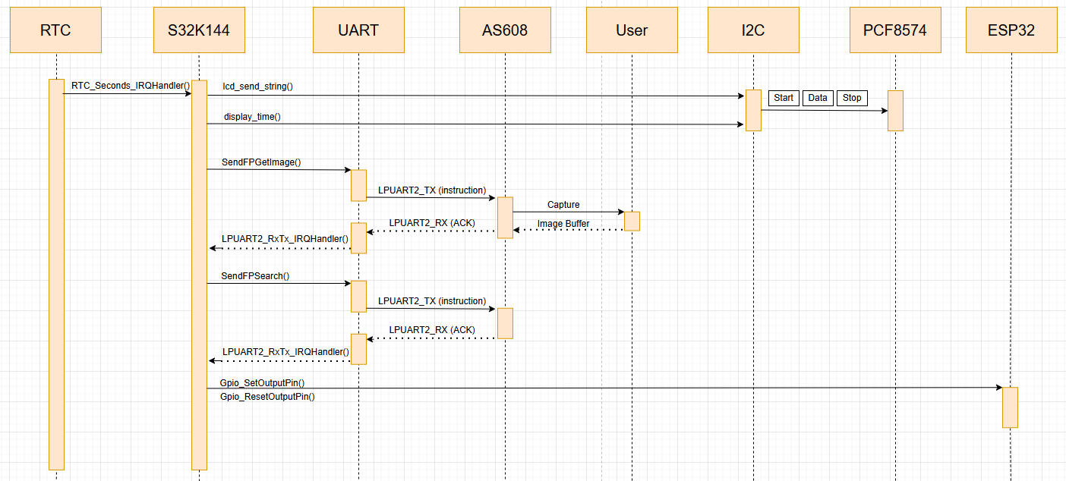
5. SOFTWARE INTRODUCTION
Search mode
5.1. Software architecture design

Slide 19
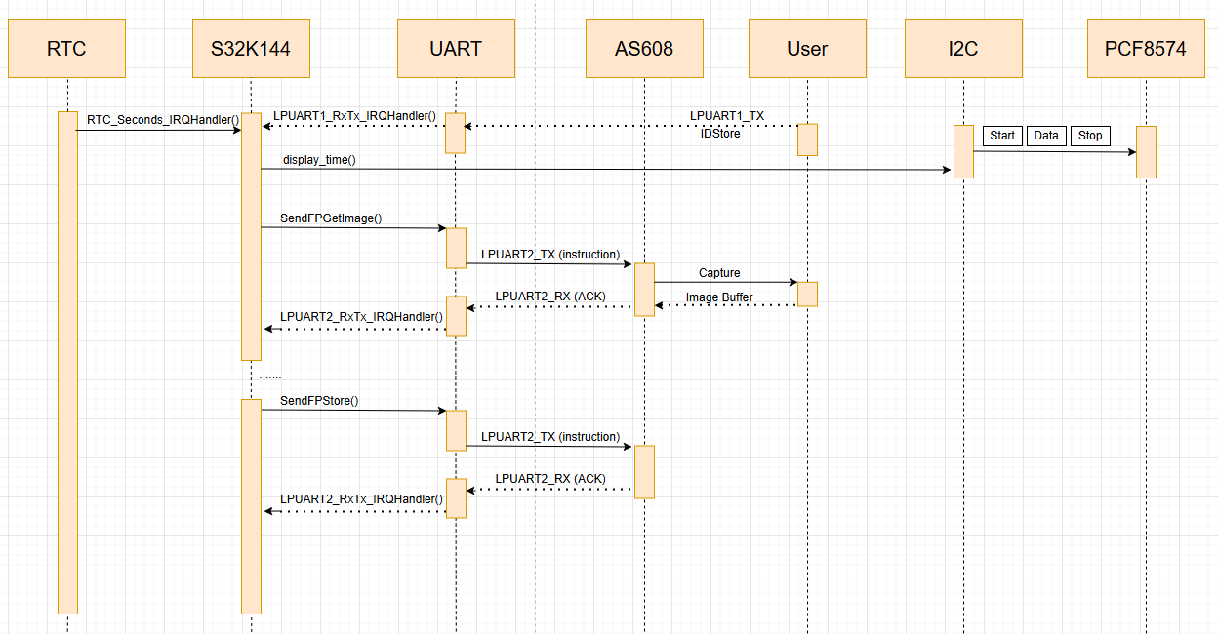
5. SOFTWARE INTRODUCTION
Add fingerprint mode
5.1. Software architecture design

Slide 20
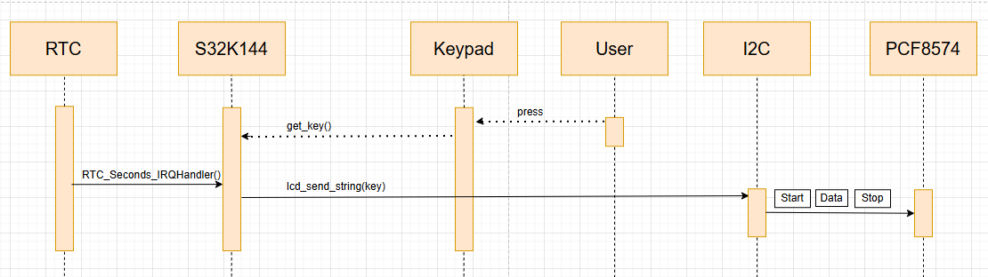
5. SOFTWARE INTRODUCTION
Create name mode
5.1. Software architecture design

Slide 21
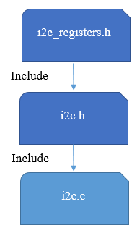
5. SOFTWARE INTRODUCTION
5.2. Software uint design
I2C API:
void init_LPI2C0(void);
unsigned char bus_busy(void);
void generate_start_ACK(unsigned char address);
void transmit_data(unsigned char data);
unsigned char generate_stop(void);
unsigned char LPI2C0_write(unsigned char s_w_address, unsigned char s_reg_address, unsigned char byte);
unsigned char LPI2C0_read(unsigned char s_w_address, unsigned char s_reg_address);
void lcd_send_cmd (char cmd);
void lcd_send_data (char data);
void lcd_clear (void) ;
void lcd_clear_rtc (void) ;
void lcd_init (void);
void lcd_send_string (char *str);
void lcd_put_cur(unsigned char row, unsigned char col);

Slide 22
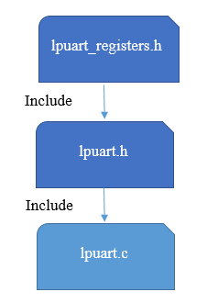
5. SOFTWARE INTRODUCTION
5.2. Software uint design
LPUART API:
void LPUART_init_clock(volatile unsigned int* PCC_LPUARTx);
void LPUART_config_baud9600(LPUART_t* LPUARTx);
void LPUART_config_baud57600(LPUART_t* LPUARTx);
void LPUART_send_byte(LPUART_t* LPUARTx, unsigned char send);
void LPUART_send_string(LPUART_t* LPUARTx, unsigned char data_string[]);
void sendFPHeader(LPUART_t* LPUARTx);
unsigned char sendFPGetImage(LPUART_t* LPUARTx, unsigned char ack[], unsigned int current_core_clock);
unsigned char sendFPCreateCharFile1(LPUART_t* LPUARTx, unsigned char ack[], unsigned int current_core_clock);
unsigned char sendFPCreateCharFile2(LPUART_t* LPUARTx, unsigned char ack[], unsigned int current_core_clock);
unsigned char sendFPCreateTemplate(LPUART_t* LPUARTx, unsigned char ack[], unsigned int current_core_clock);
unsigned char sendFPDeleteAllFinger(LPUART_t* LPUARTx, unsigned char ack[], unsigned int current_core_clock);
unsigned char sendFPSearchFinger(LPUART_t* LPUARTx, unsigned char ack[], unsigned int current_core_clock);
unsigned char SendStoreFinger(unsigned char IDStore, LPUART_t* LPUARTx, unsigned char ack[], unsigned int current_core_clock);
unsigned char SendDeleteFinger(unsigned short int IDDelete, LPUART_t* LPUARTx, unsigned char ack[], unsigned int current_core_clock);
void DeleteAllFinger(LPUART_t* LPUARTx, unsigned int core_clock);
void check_response_fingerprint(unsigned char response) ;

Slide 23
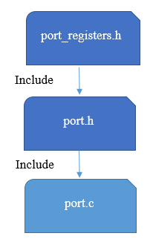
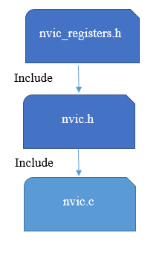
5. SOFTWARE INTRODUCTION
5.2. Software uint design
PORT API:
void Port_Init(Port_Type *pPORTx, unsigned char PinNumber, Port_Mode_t Mode);
NVIC API:
void NVIC_EnableIRQ(unsigned int IRQn);
void NVIC_DisableIRQ(unsigned int IRQn);
void NVIC_SetPendingIRQ(unsigned int IRQn);
void NVIC_ClearPendingIRQ(unsigned int IRQn);
unsigned int NVIC_GetActive(unsigned int IRQn);
void NVIC_SetPriority(unsigned int IRQn, unsigned int priority);
unsigned int NVIC_GetPriority(unsigned int IRQn);
void NVIC_TriggerIRQ(unsigned int IRQn);

Slide 24
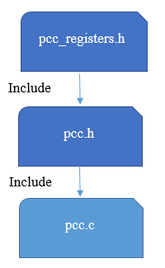
5. SOFTWARE INTRODUCTION
5.2. Software uint design
PCC API:
void PCC_EnableClock(volatile unsigned int *pccRegister);
void PCC_DisableClock(volatile unsigned int *pccRegister);
void PCC_SetClockSource(volatile unsigned int *pccRegister, unsigned int clockSource);
void PCC_SetClockFraction(volatile unsigned int *pccRegister, unsigned int clockFraction);
void PCC_SelectClockDivider(volatile unsigned int *pccRegister, unsigned int clockDivider);
unsigned int PCC_GetClockStatus(volatile unsigned int *pccRegister);
unsigned int PCC_IsPeripheralPresent(volatile unsigned int *pccRegister);

Slide 25
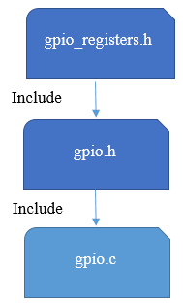
5. SOFTWARE INTRODUCTION
5.2. Software uint design
GPIO API:
void Gpio_Init(const Gpio_ConfigType* ConfigPtr);
void GPIO_WriteToOutputPin(GPIO_Type *pGPIOx, unsigned char PinNumber, unsigned char value);
void GPIO_SetOutputPin(GPIO_Type *pGPIOx, unsigned char PinNumber);
void GPIO_ResetOutputPin(GPIO_Type *pGPIOx, unsigned char PinNumber);
void GPIO_ToggleOutputPin(GPIO_Type *pGPIOx, unsigned char PinNumber);
unsigned char GPIO_ReadFromInputPin(GPIO_Type *pGPIOx, unsigned char PinNumber);

Slide 26
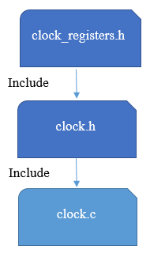
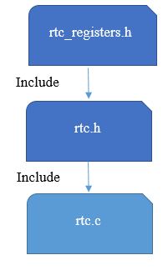
5. SOFTWARE INTRODUCTION
5.2. Software uint design
CLOCK API:
void set_system_clock_source(unsigned int source);
void SOSC_init_8MHz(void);
void SPLL_init_160MHz(void);
void NormalRUNmode_80MHz (void);
RTC API:
void RTC_init(void);

Slide 27
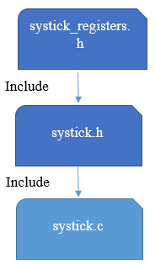
5. SOFTWARE INTRODUCTION
5.2. Software uint design
SYSTICK API:
void SysTick_Enable();
void SysTick_Init(systick_config_t config);
void SysTick_Disable();
void delay(unsigned int ms, unsigned int core_clock);
void SysTick_SetReload(unsigned int reload);

Slide 28
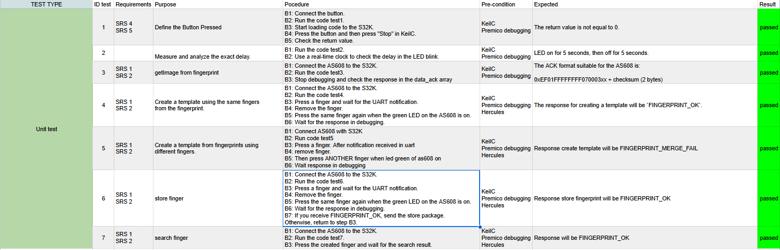
6. TESTING

Slide 29
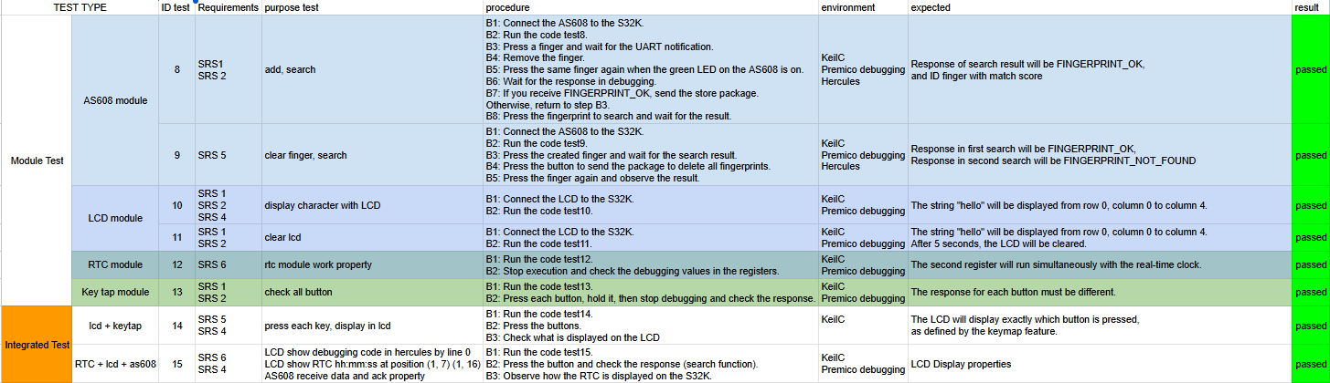
6. TESTING

Slide 30
7. Demo system

Slide 31
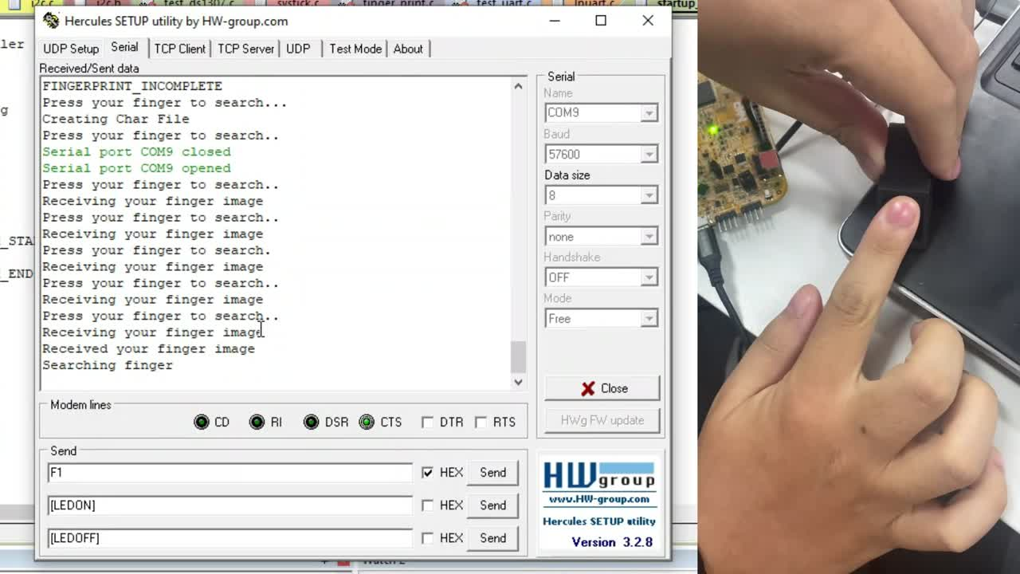

Slide 32
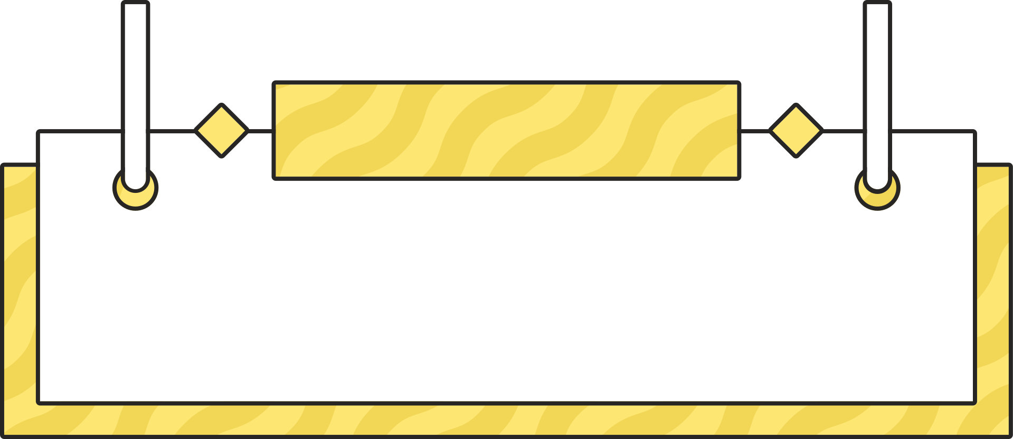

8. Advantages, Disadvantages, Development Directions
Advantages
Disadvantages
High Scalability
High Latency
High Accuracy Across Multiple Trials
Non-continuous real-time clock
Cannot add without connection with laptop
Flexible Debugging

Slide 33
8. Advantages, Disadvantages, Development Directions
Development Directions
Record Fingerprint Scan History via Wi-Fi
Optimize Latency
Utilize more LCD for Expanded Display Space

Slide 34
9. Which learned?
Working with discipline
Improving teamwork skills
Enhancing document reading skills
Enhancing problem-solving skills
Improving debugging skills
Gaining knowledge about microcontrollers

Slide 35
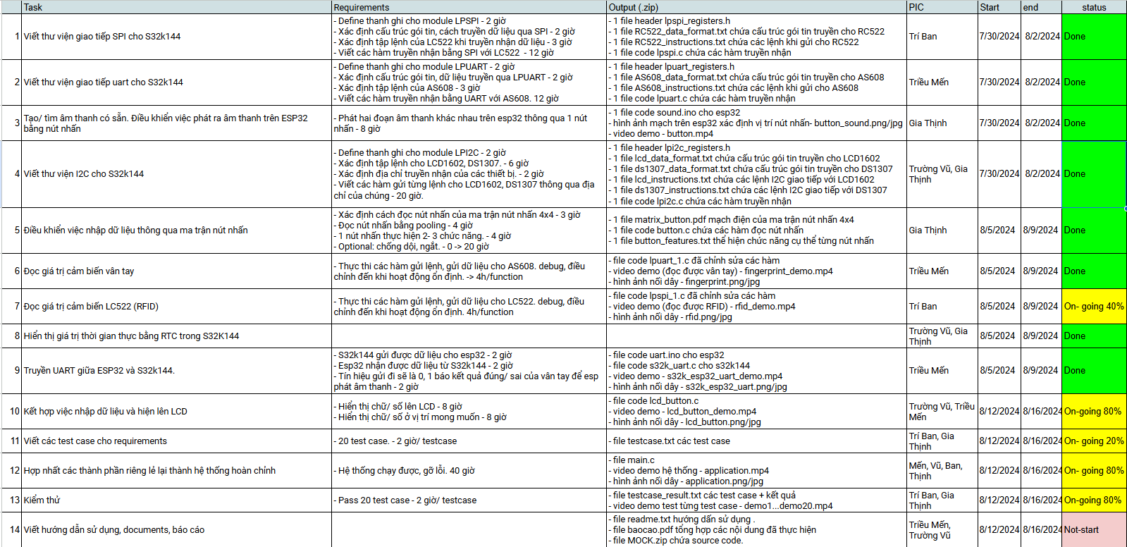
10. Plan

Slide 36
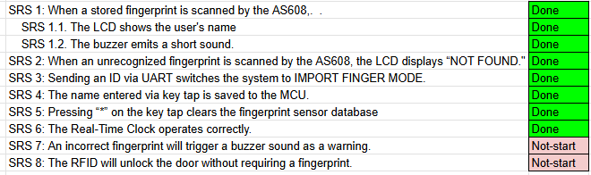
11. Result

Slide 37
THANK YOU

